Slide 1

sentiment analysis using NLP
supervised by dr.Alaa Hamdy
supervised by dr.Jamila mohamed
presented by bassem mohamed 2021/08471

Slide 2
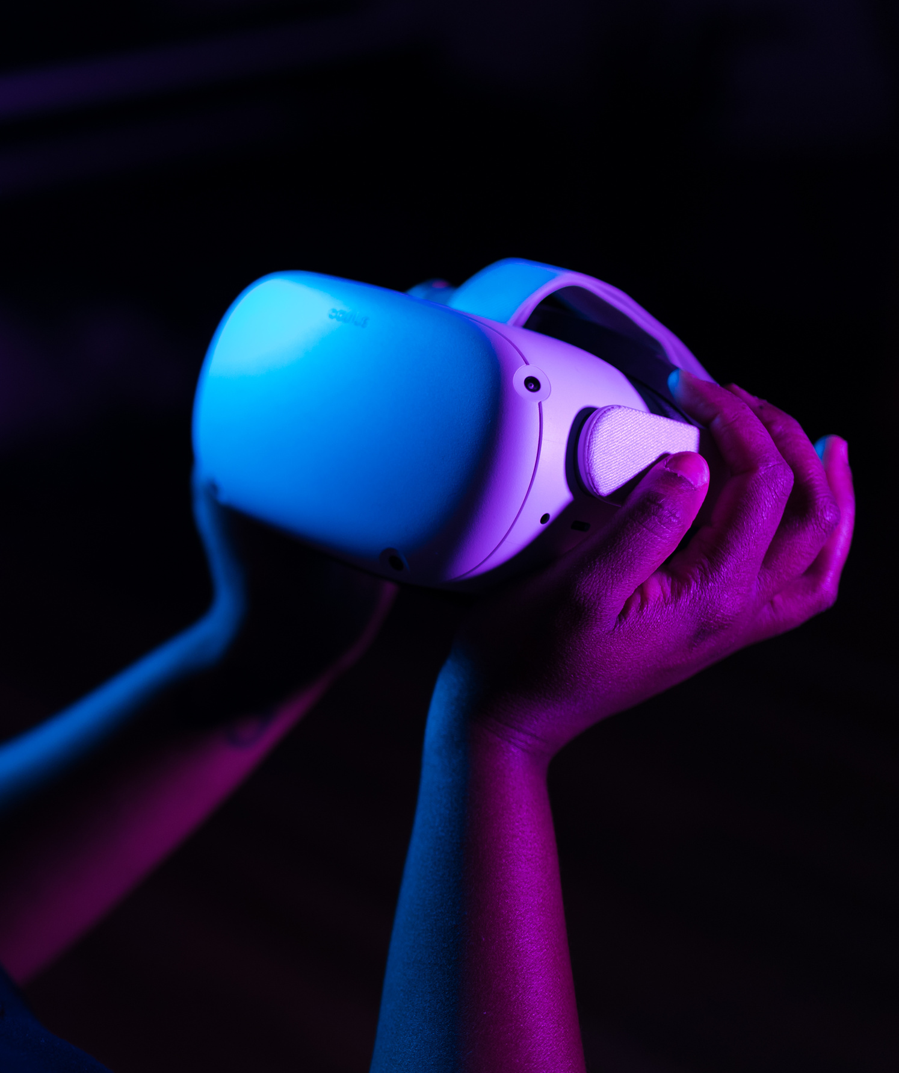
Introduction to the topic
Sentiment analysis is the process of identifying and categorizing opinions in text into positive or negative.
It's widely used in social media monitoring, customer feedback, and market research.
Deep learning models, especially transformers, have dramatically improved accuracy.
Common datasets include IMDB movie reviews, Twitter sentiment, and product reviews.
Key steps: data cleaning, tokenization, model training, and evaluation.

Slide 3
Uses the Stanford IMDB dataset: 25 000 labeled train and 5000 labeled validation and 10000 test reviews from IMDb.
Directory structure: aclImdb/train/pos, train/neg, test/pos, test/neg extracted from tar.gz.
Columns in train.csv: text, text_len (number of characters), score (rating 1–10), and binary label (1=pos, 0=neg).
Test CSV includes: text, score, and label, with the same positive/negative split.
HTML tags stripped via BeautifulSoup for clean text input.
Balanced classes: equal number of positive and negative samples.
score derived from filename indicates original review rating, used for analysis but not for training label
dataset overview

Slide 4



preprocessing steps made on this dataset
splitting data
tokenizing the text
building the data loader and the batches
optimisng the models on current dataset
removing stop words
lower casing texts
punctuation removal

Slide 5

methodology and models used
custom cnn-lstm
roberta-base
DistilBERT

Slide 6
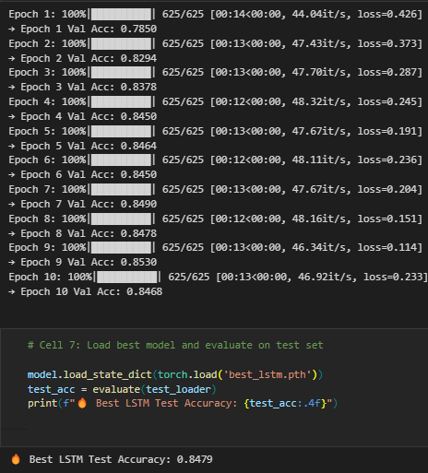

custom made cnn-lstm
Architecture: Embedding → CNN (128 filters, k=3) → BiLSTM (128 units) → FC.
Epochs: up to 10 with early stopping (patience=2), Batch size: 32, LR: 1e-3.
Validation accuracy: ~85.2% at best epoch.
Test accuracy: 84.79%.

Slide 7
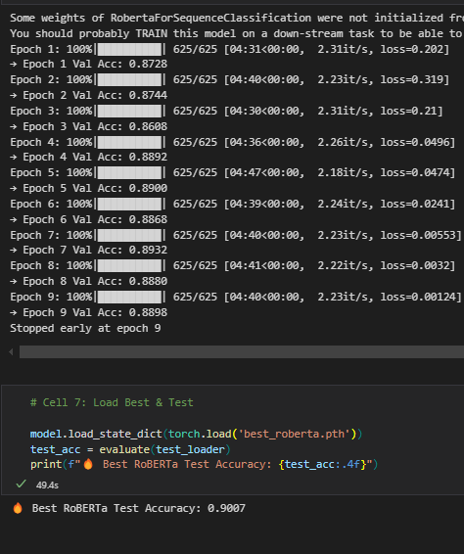
RoBERTa-base
Model: roberta-base fine-tuned with cleaner preprocessing.
Epochs: 4 (with early stop), Batch size: 32, LR: 2e-5.
Validation accuracy: peaked at ~89.32%.
Test accuracy: 90.07%.

Slide 8
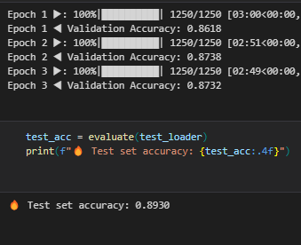
Pretrained DistilBERT
Model: distilbert-base-uncased fine-tuned for 3 epochs.
Batch size: 16, LR: 2e-5, Scheduler: linear warmup (10%).
Validation accuracy: ~87.4% after epoch 2.
Test accuracy: 89.30%.

Slide 9
conclusion
RoBERTa-base achieved the highest test accuracy (90.07%) among all models.
Pretrained transformer fine‑tuning consistently outperforms architectures trained from scratch.
Comprehensive text cleaning (HTML stripping, lemmatization, stop‑word removal) boosts model performance.
Early stopping and careful hyperparameter tuning prevent overfitting and undertraining.
Future improvements: model ensembles, larger datasets, and multi‑class sentiment analysis.
Key applications: brand monitoring, customer feedback analysis, and social media insights.
Overall, transformer fine‑tuning is a robust, scalable solution for sentiment analysis tasks.

Slide 10

Thank You & Looking Ahead

